Slide 1


Matan Peled, Idan Schwartz, Maayan Kislev

Slide 2


Content
Introduction
Arduino Model
Windows Phone Application
Azure Server

Slide 3
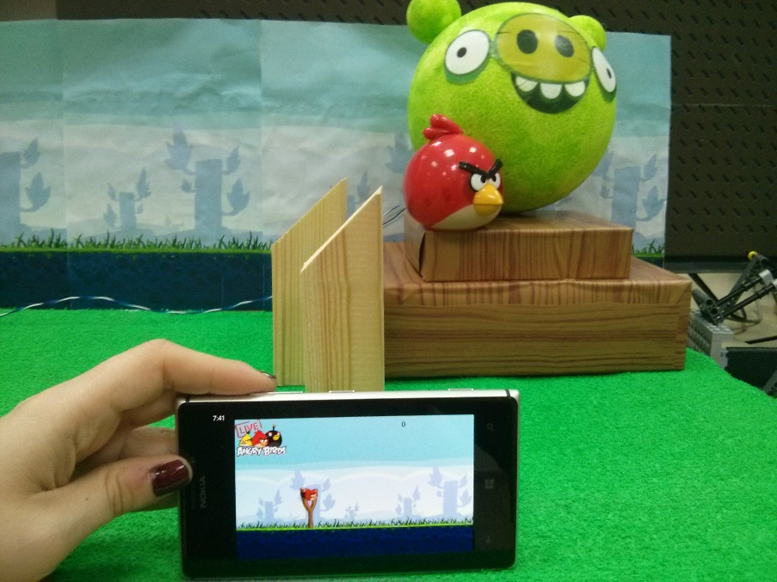
Introduction
The idea of our project is to combine a Windows Phone game of Angry Birds with a real-life game model built using Arduino. The player can control the model using the application, see the results live in front of him, and later view his best scores uploaded to Azure website.

Slide 4

Arduino Model

Slide 5
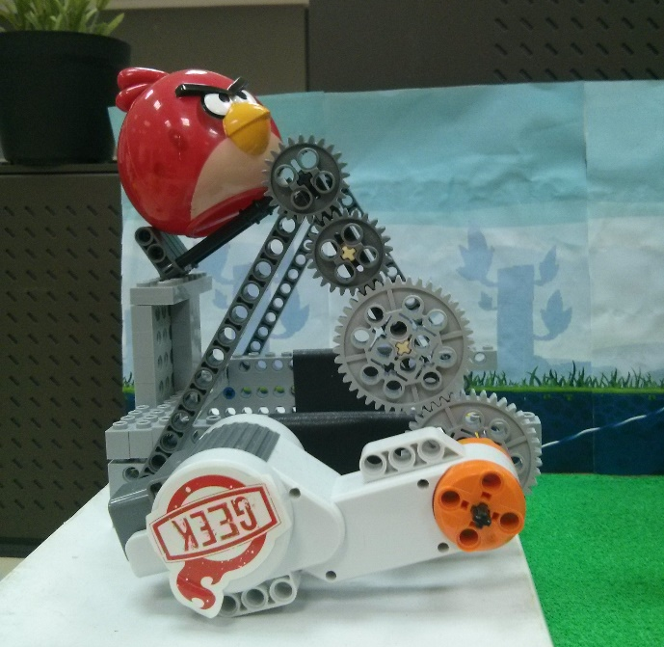
Lego Model
The first model we built was a catapult using Lego parts and NXT motor.
The Arduino controls when to start the catapult, which direction to throw and the intensity of the throw.
The intensity is changed from one throw to another based on data received from the application.

Slide 6
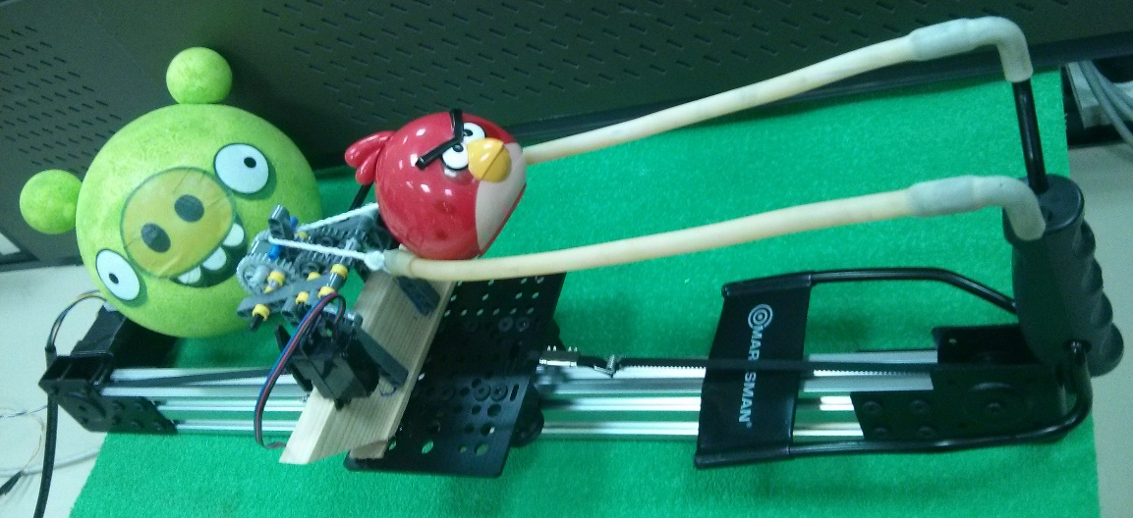
Slide Motor
The second model we built is a slingshot using a stepper motor
and a Servo-based trigger mechanism, using a lego gear system to make sure the servo is not overpowered.
The Arduino controls when to start moving the slingshot, the direction and distance of the travel and when to release the trigger mechanism.

Slide 7
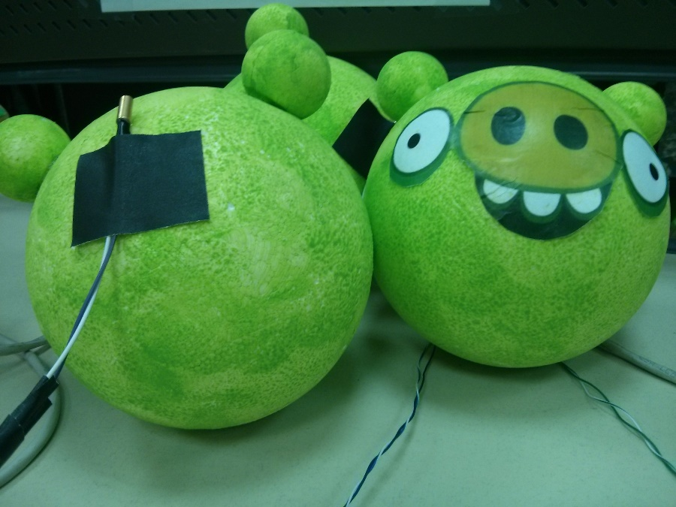
Pigs
In order for the application to present results in real-time we attached a tilt sensor to each of the pigs.
The tilt sensors are connected to the Arduino and report changes in tilt status.
That information sent to the application after each throw in order to calculate the score.

Slide 8
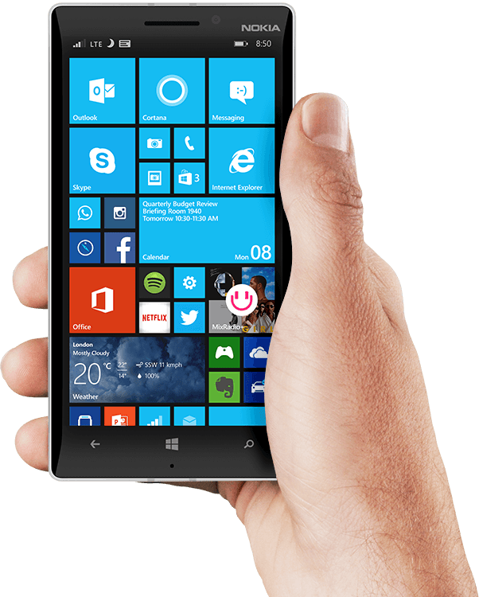
Windows Phone Application

Slide 9
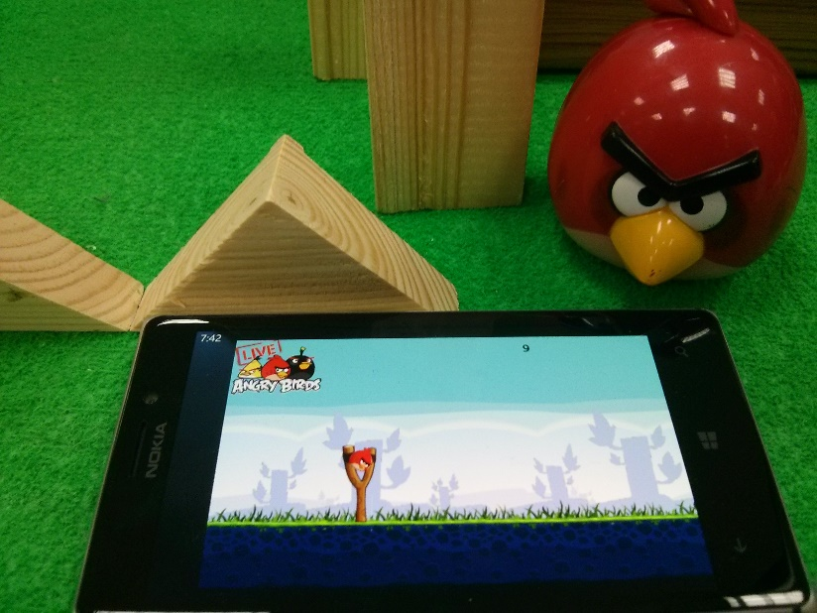
XNA Game
The Angry Birds Live Application serves as an interface for the
player to control the parameters of his throw and view his score.
The application sends information about the time and distance of the throw to the Arduino.
After the bird is thrown, the application queries the Arduino for information about the pigs.

Slide 10
Communication with Arduino
The Arduino is programmed to work as a server and can receive and transmit messages through TCP/IP connection.
Input to Arduino: 1) Current position of the bird 2) Moment of releasing the bird
Output from Arduino: Damage status for each one of the pigs The result of each throw is calculated based on the status of the pigs.

Slide 11
Communication Protocol
Move - mNNN
Fire - ffff
Read - rrrr → XYZ

Slide 12
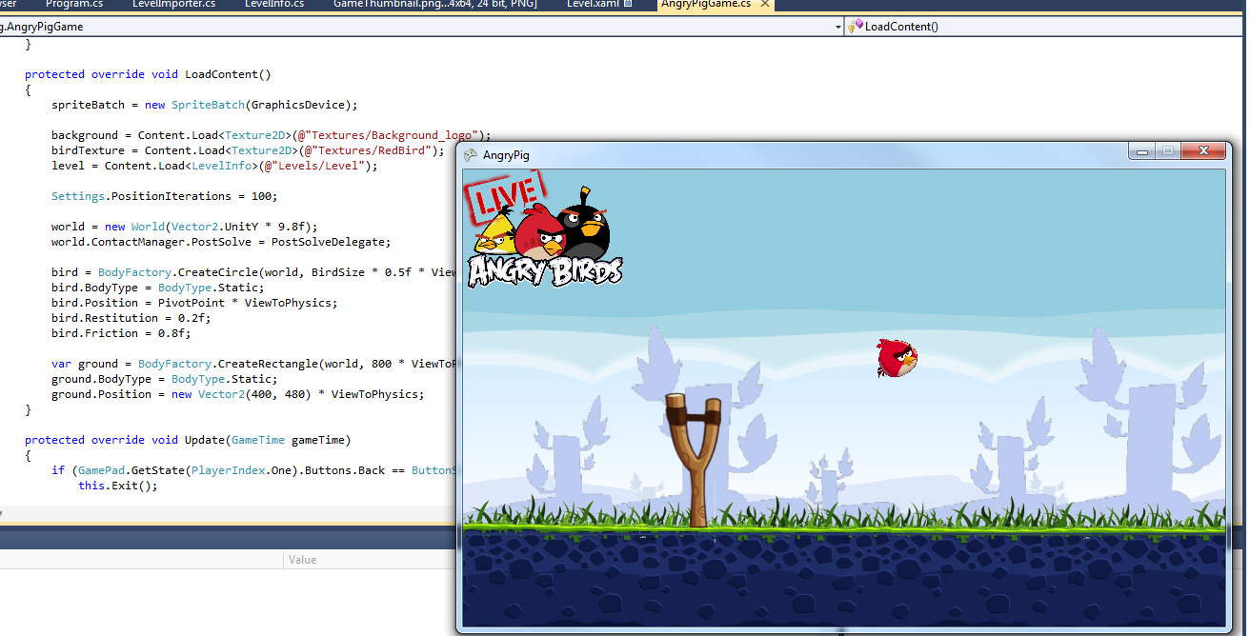
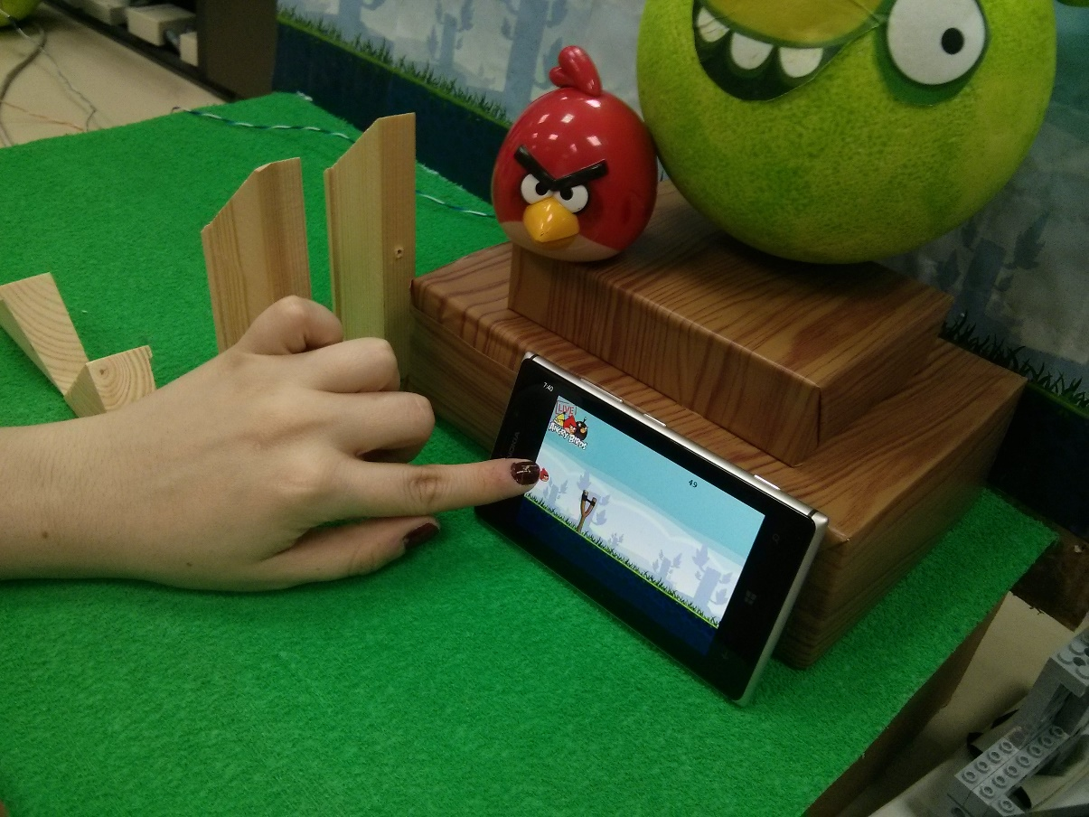

Slide 13
Azure Server

Slide 14
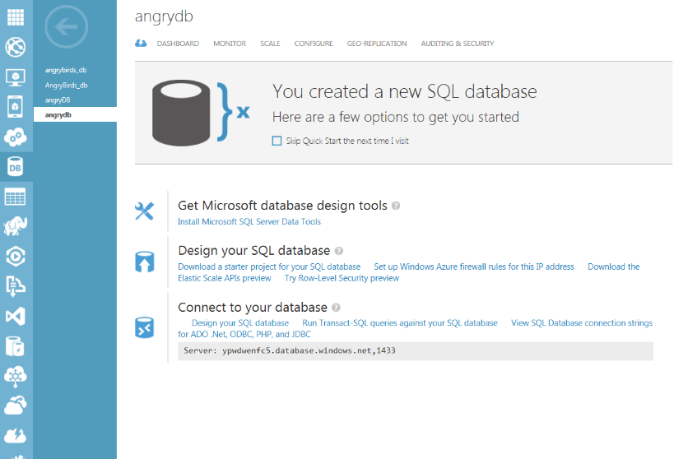
Azure SQL Database
We used Azure SQL Database to store the highest scores of the game with the following parameters: Name, Time, Score.
After the “Angry Bird Live” application receives data from the tilt sensors and calculates the score, a cloud service is used in order to send data to Azure SQL Database.

Slide 15
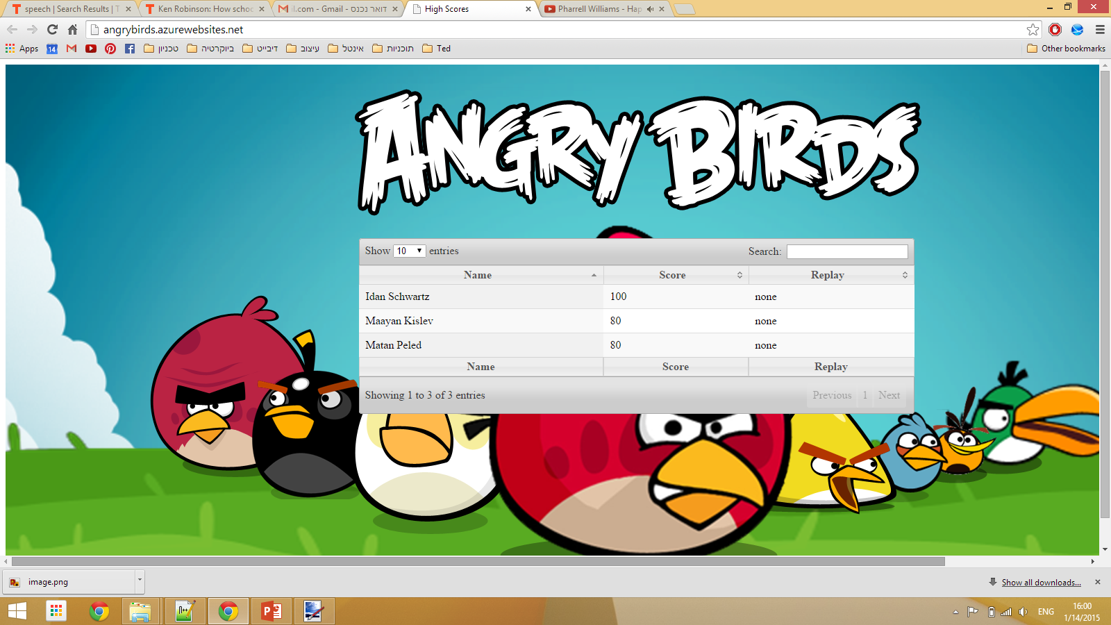
High-Score Website
In order to present the results we built a website on Azure platform for users to view their highest results playing our game: http://angrybirds.azurewebsites.net/
The website is developed in ASP.NET using jQuery library and stored on Azure cloud.

Slide 16

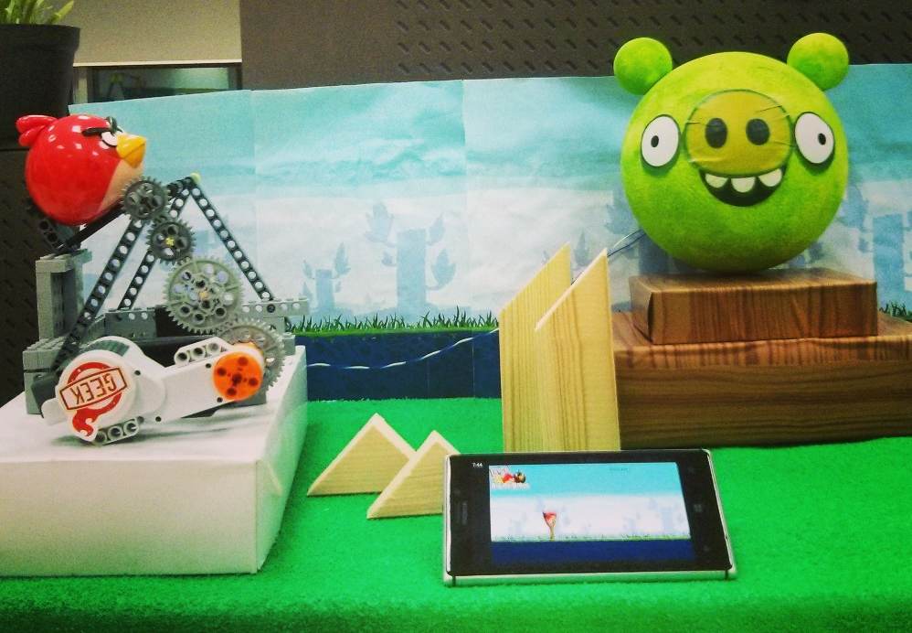
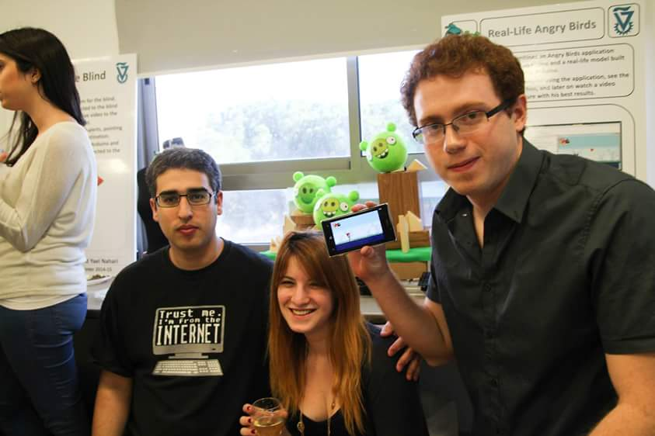
Thank You!!

